Slide 1
E-Commerce Web App
Group G-4
https://github.com/aryanjuyal37/E-Commerce-G4

Slide 2
Team Members
Ishaan Gurnani- Home Page, Navbar, Products
Pushpak Gupta- Home Page, Navbar, Products
Tanmay Jani- Log In Page, Cart Page and the Design
Kshitij Kamble- Log In Page, Cart Page and the Design
Hardik Nahar- Checkout Page, Orders Page
Aryan Juyal- Firebase Authentication, Firebase Orders DB, Stripe Payments

Slide 3

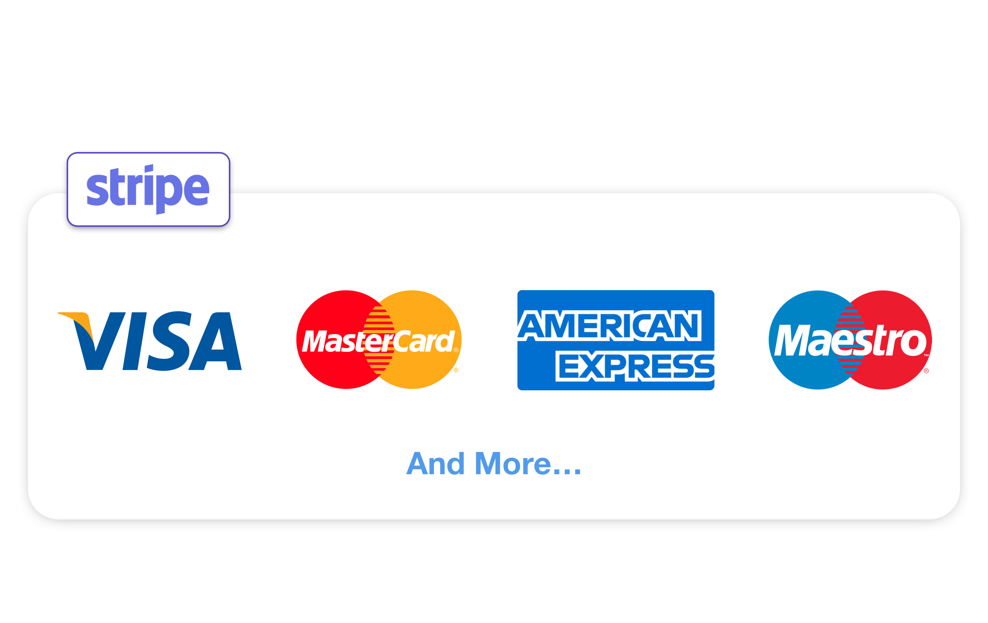

What we have used
React JS Library for the web application.
HTML, CSS and React Context API(allows us to pass data through our component trees, giving our components the ability to communicate and share data at different levels).
Googles Firebase for Web App Development (Our Backend Database).
Stripe Payment Processing.

Slide 4
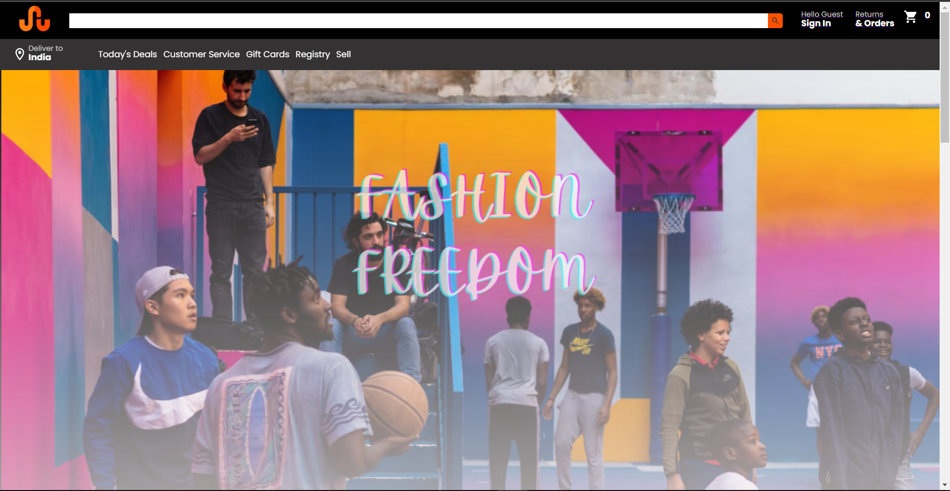
Home Page

Slide 5
What is in the Home Page
Navbar at the top with the website logo, a search bar, a sign in component, returns and orders component and a cart component.
Secondary Navbar showing many user specific options.
Cover Ad up and center.
Cart Icon shows you the number of items in your cart and you can navigate to your cart by pressing it.
The Sign in component shows the user who has signed in and also redirects you to sign in page on pressing it.
Return and Orders component will redirect you to the Order History Page for the specific user.

Slide 6

Home Page( with User and Cart Items)

Slide 7
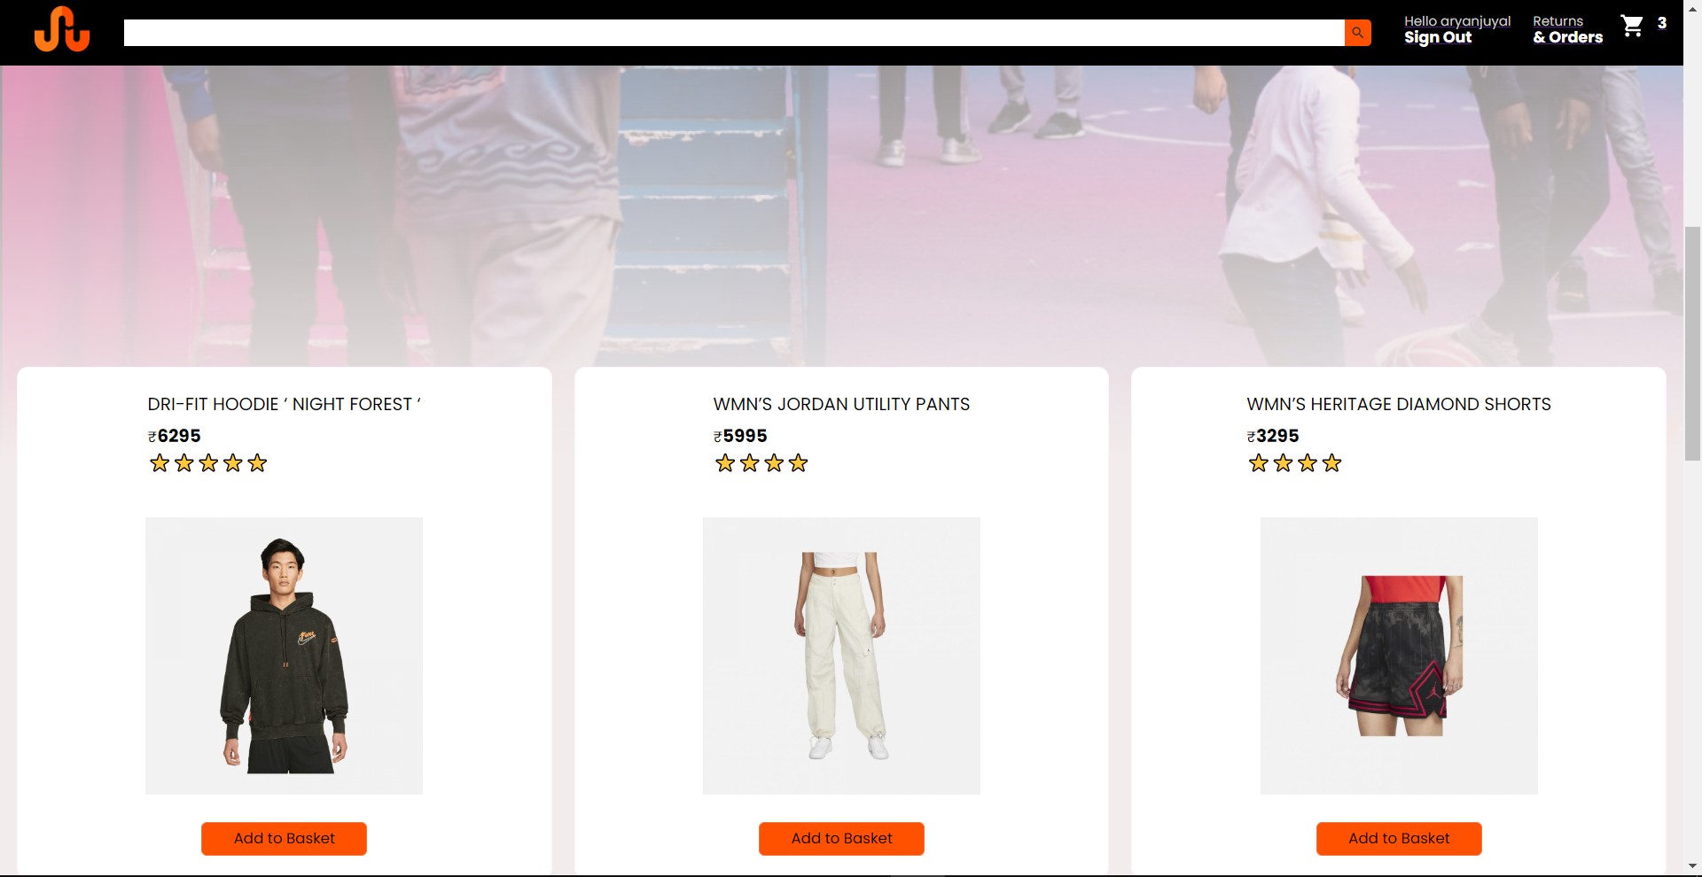
Products

Slide 8
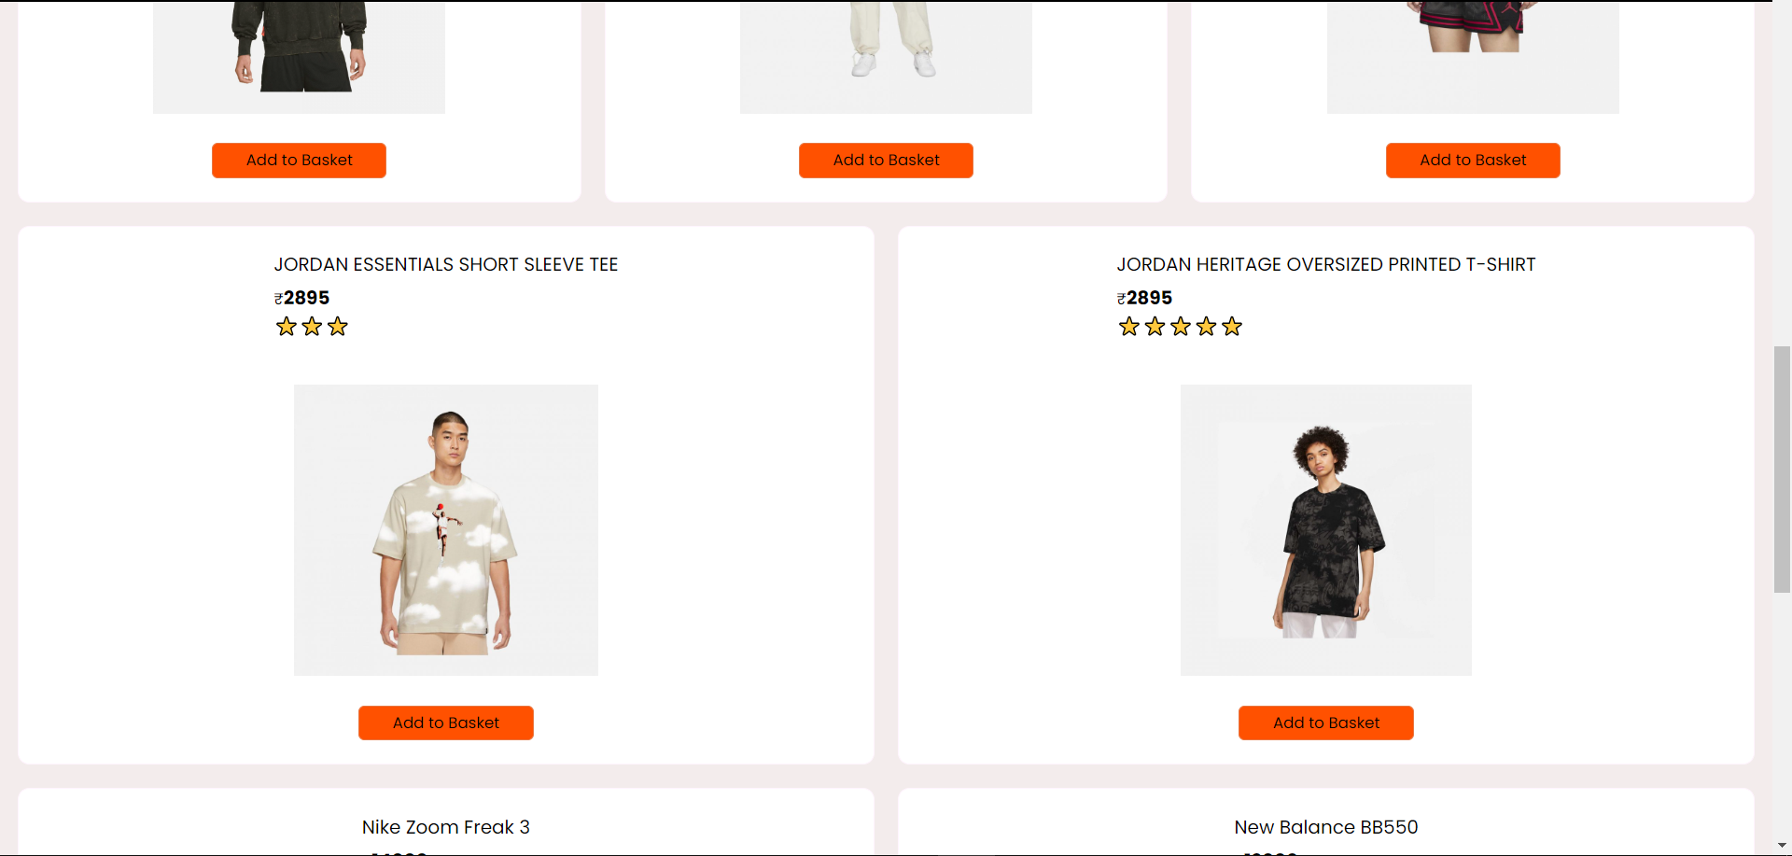
Products

Slide 9
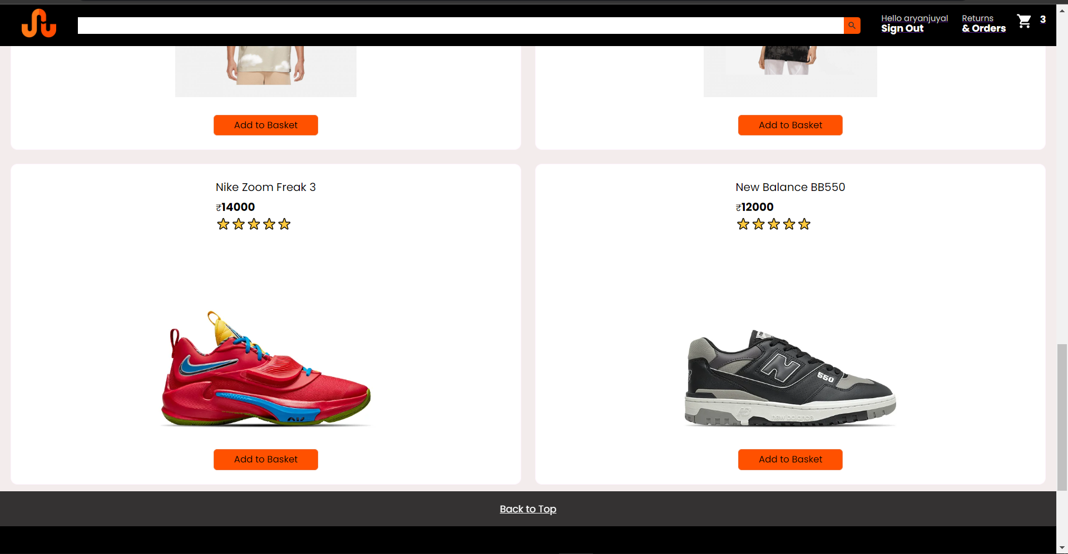
Products

Slide 10
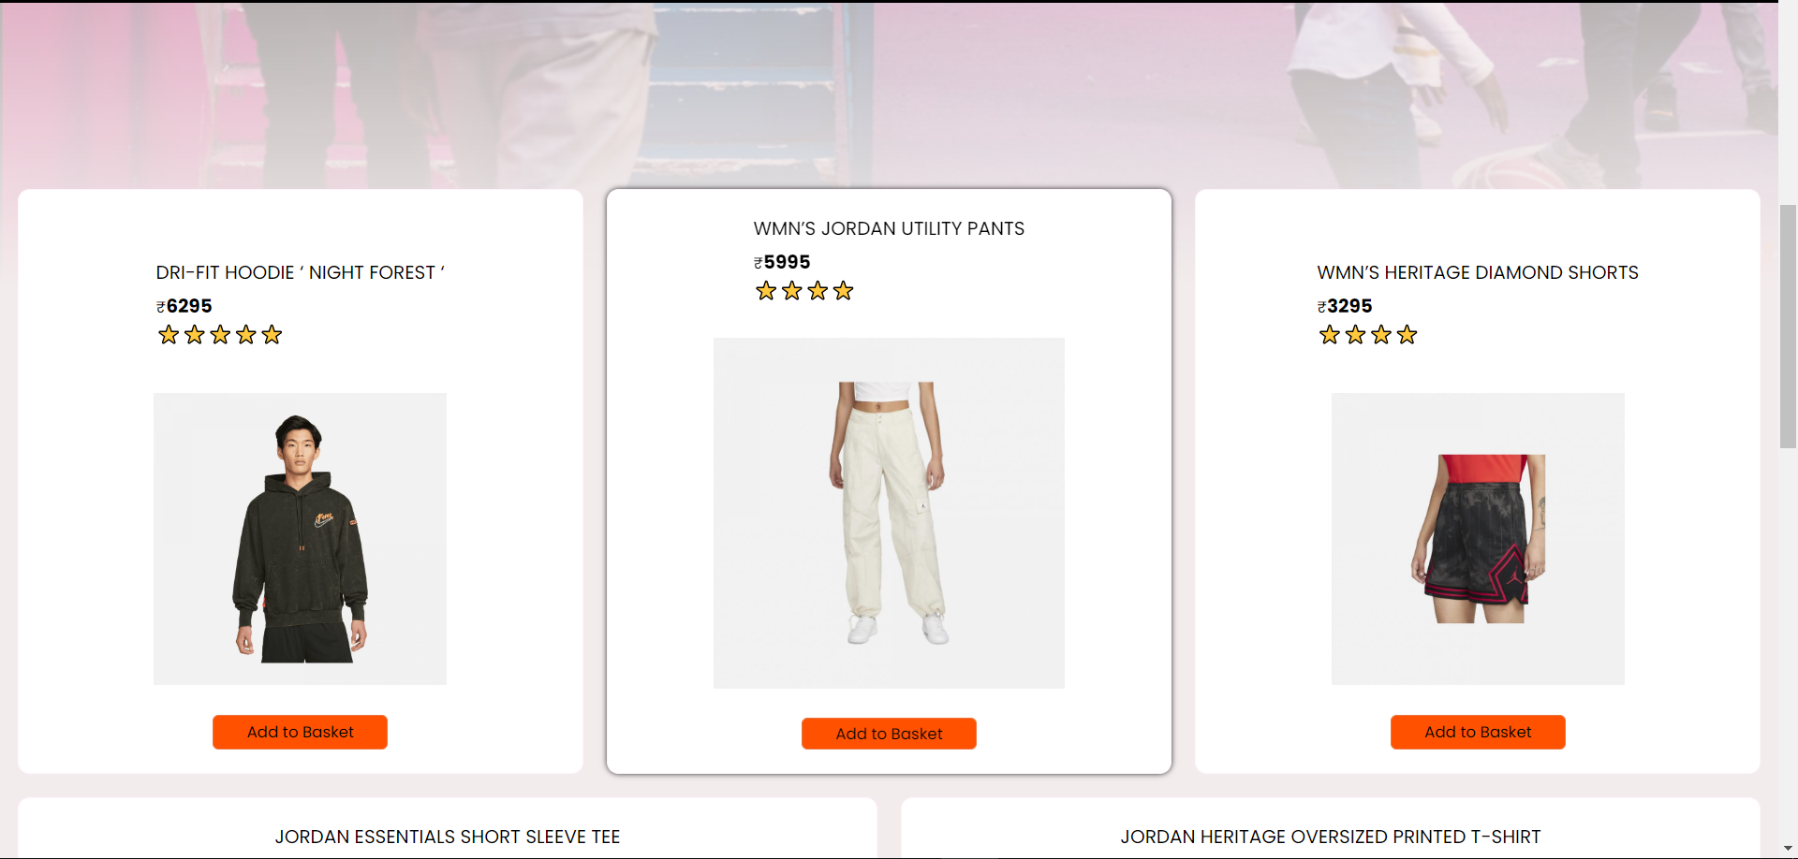
Cursor Hover on Products

Slide 11
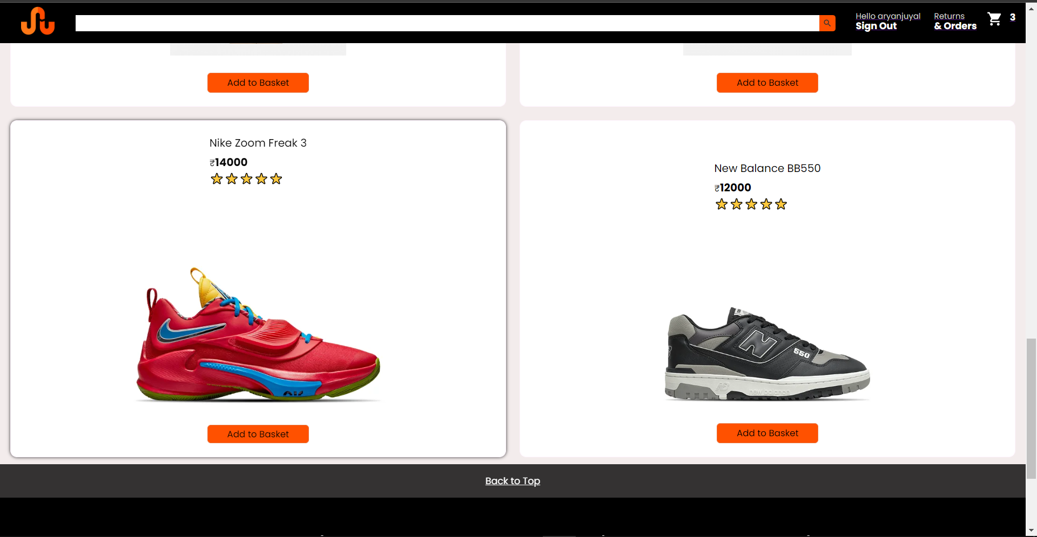
Cursor Hover on Products

Slide 12
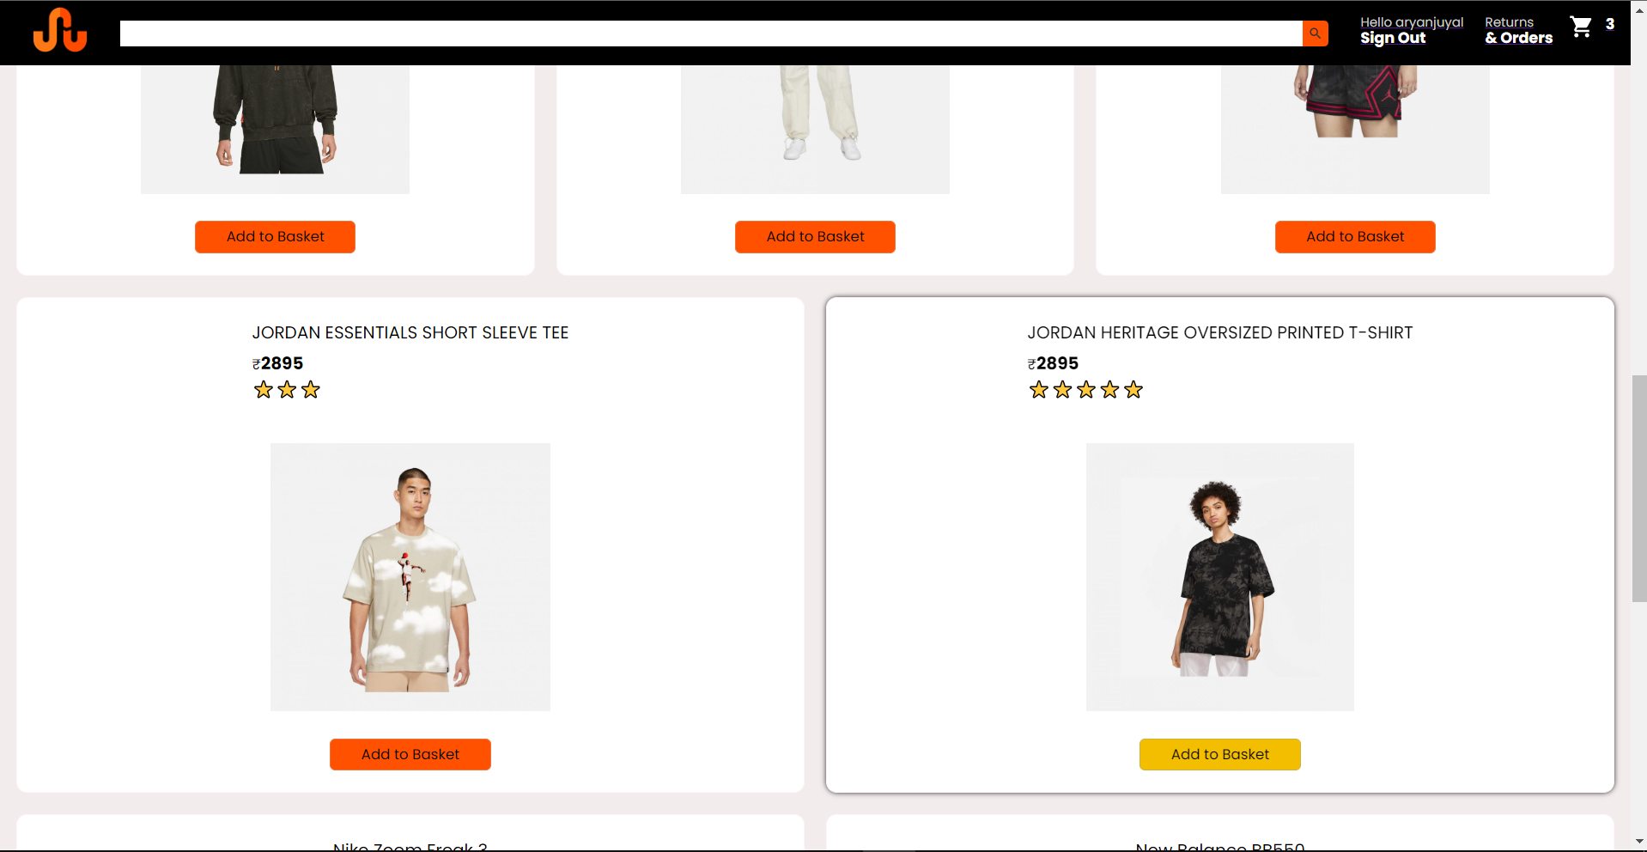
Add to Basket Hover

Slide 13
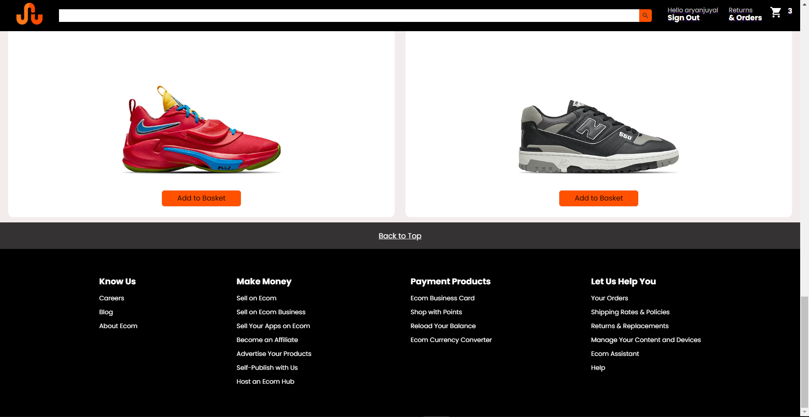
Footer

Slide 14
Products
Add to Basket adds the item to the cart and the number of items is updated on the navbar cart component.
Hovering over the button changes its color and hovering over the products expands it.
Back to top button at the bottom to navigate you back to the top of the page.
Footer for general user specific info and help.

Slide 15
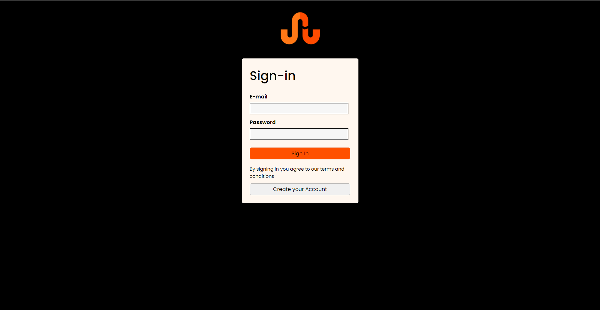
Sign In and Create Your Account

Slide 16
Create Your Account
Enter your email id , type in a password and press the create your account.
A new entry will be made into the firebase database.
Incase the account already exists it will show an error for the same.
You can then sign in typing in the email and password and pressing the sign in button.
Redirected to the Homepage with your account name near user label.

Slide 17
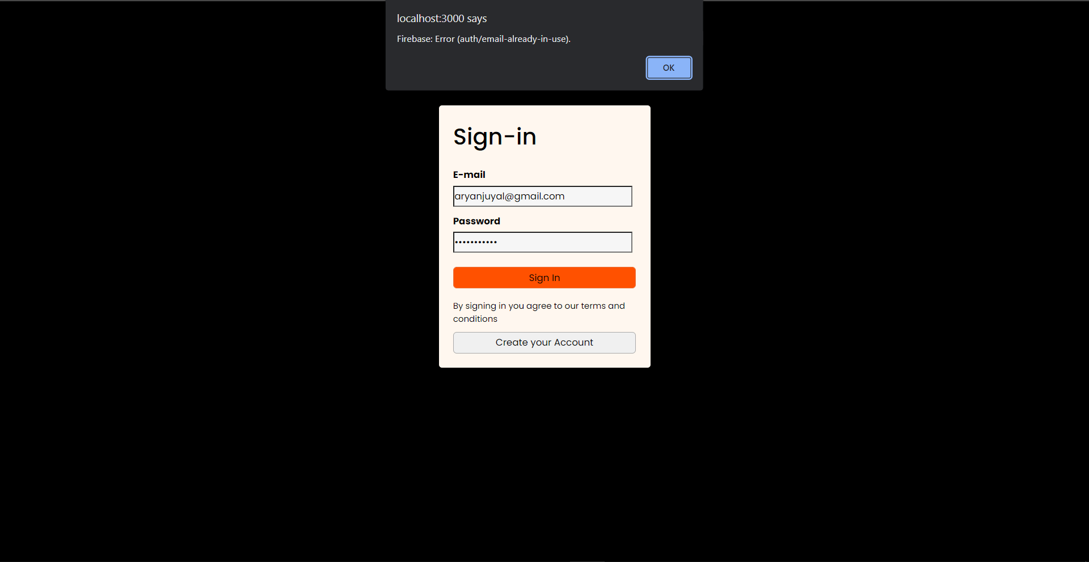
Already Exist Account Error

Slide 18

Wrong password error

Slide 19
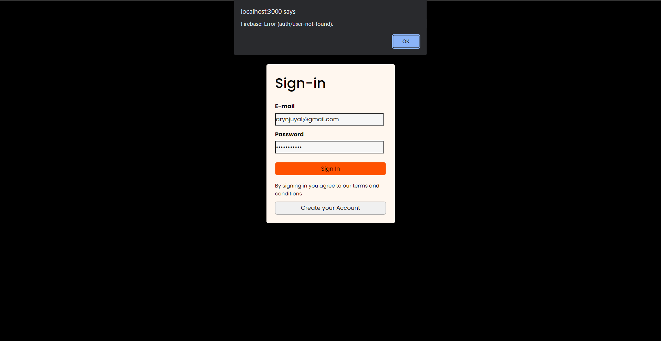
Wrong or Missing User

Slide 20
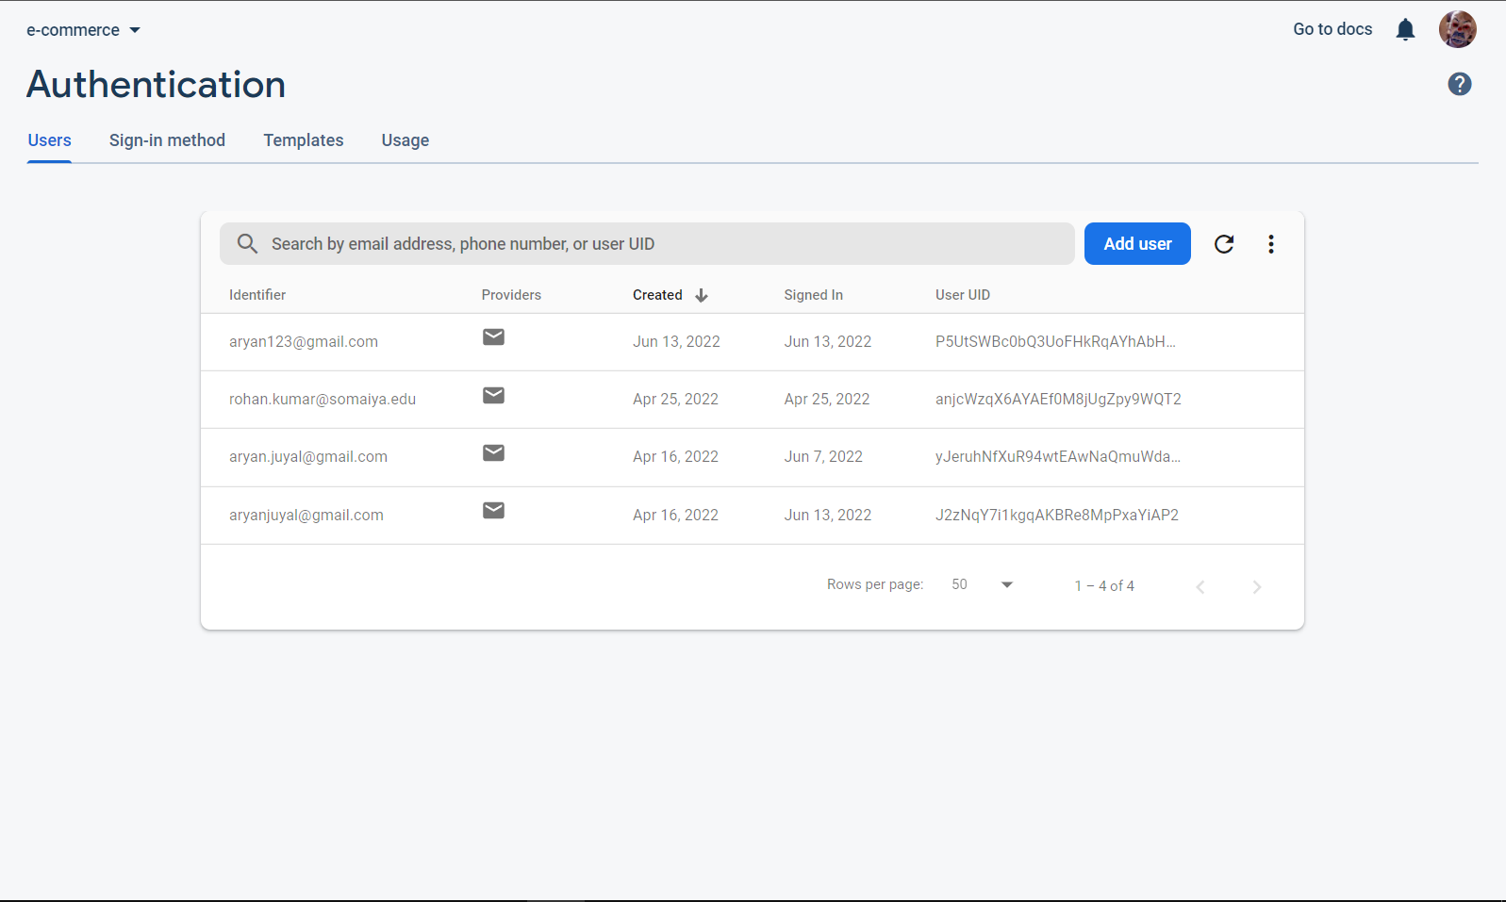
Firebase DB Users

Slide 21
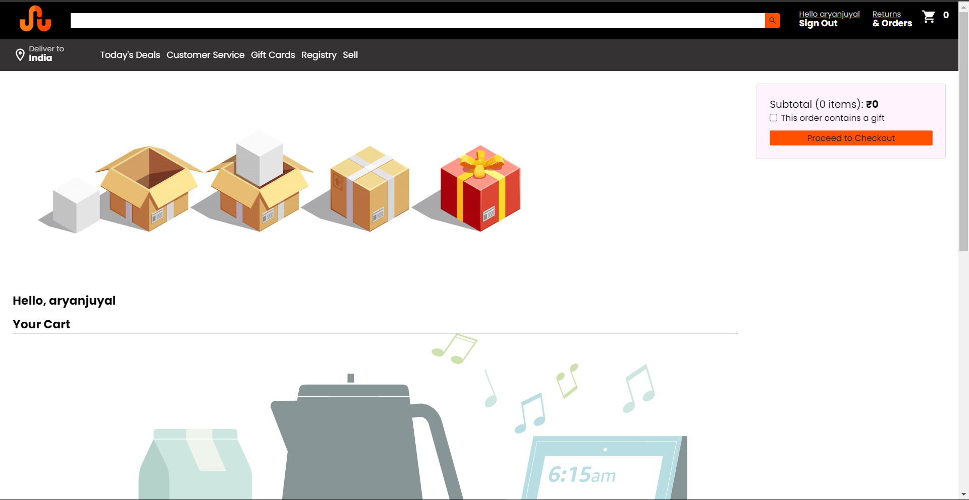
Cart Page (Empty)

Slide 22
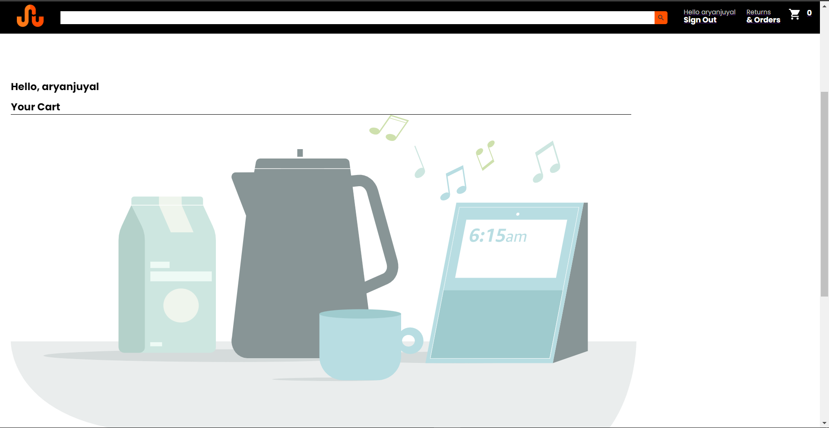
Cart Page (Empty)

Slide 23
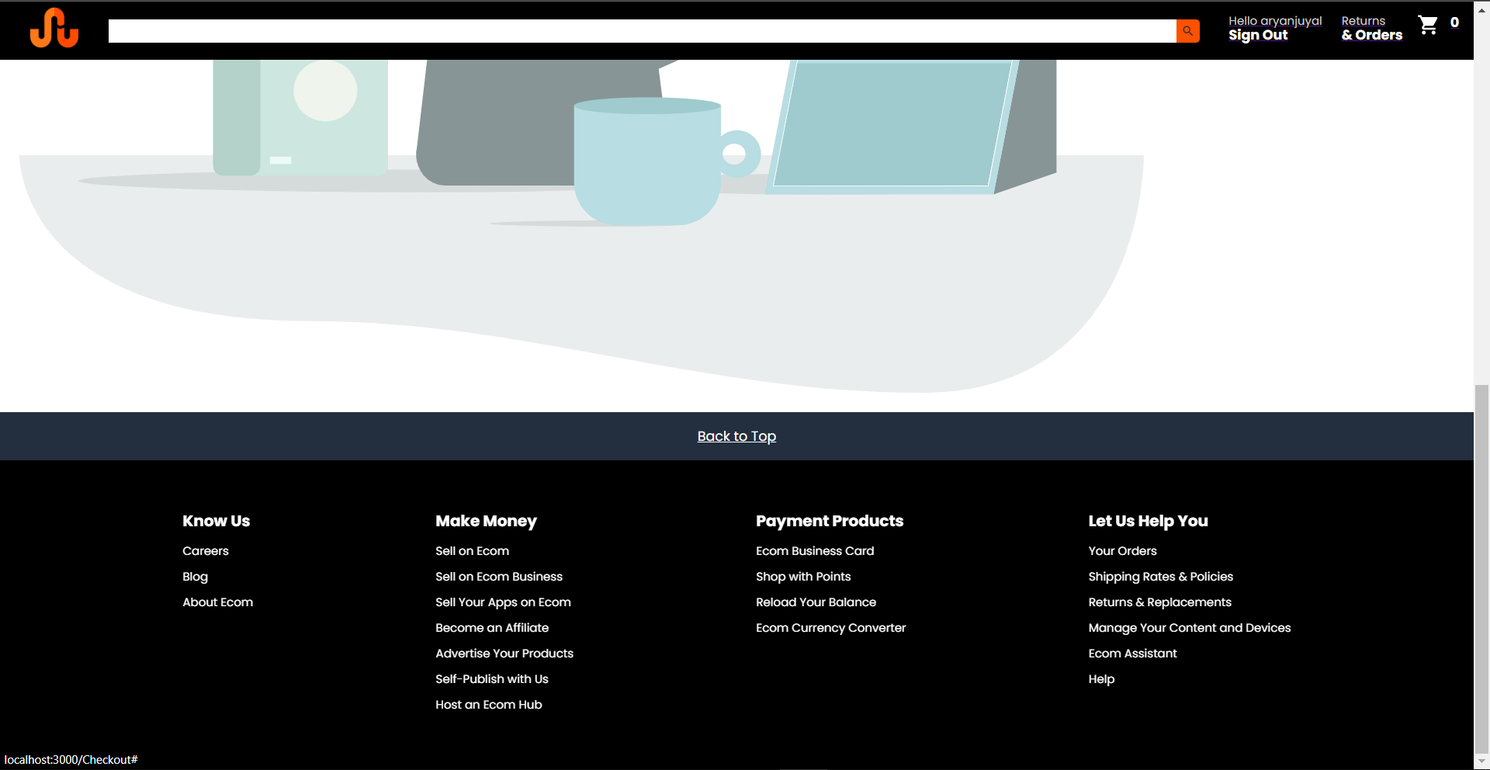
Cart Page (Empty)

Slide 24
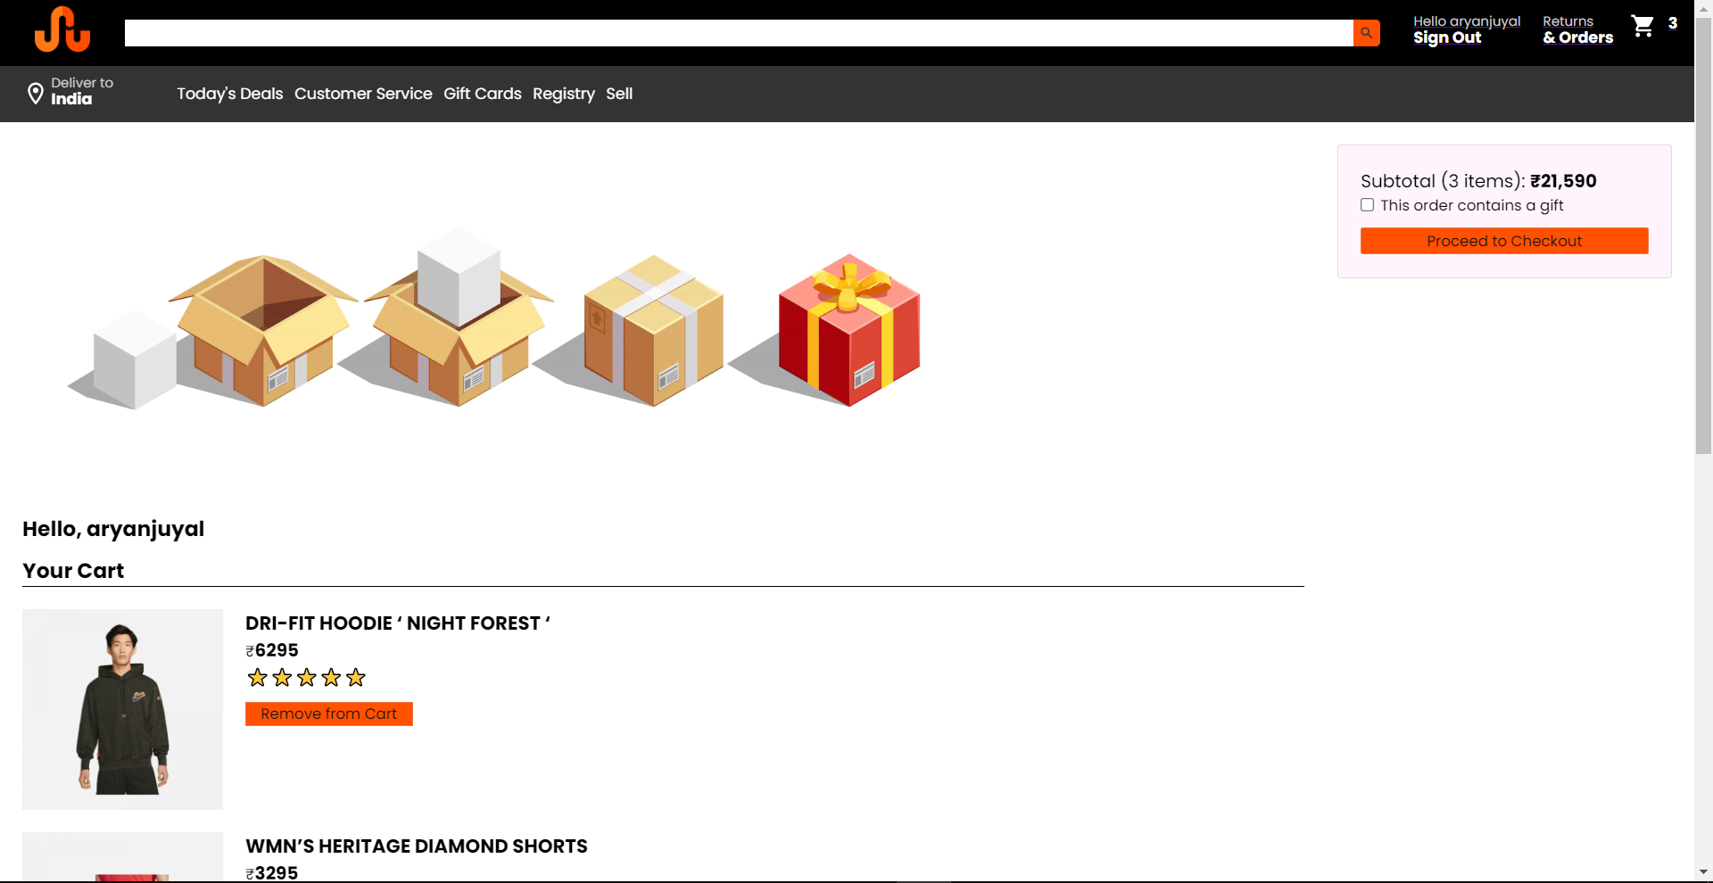
Cart with Items

Slide 25
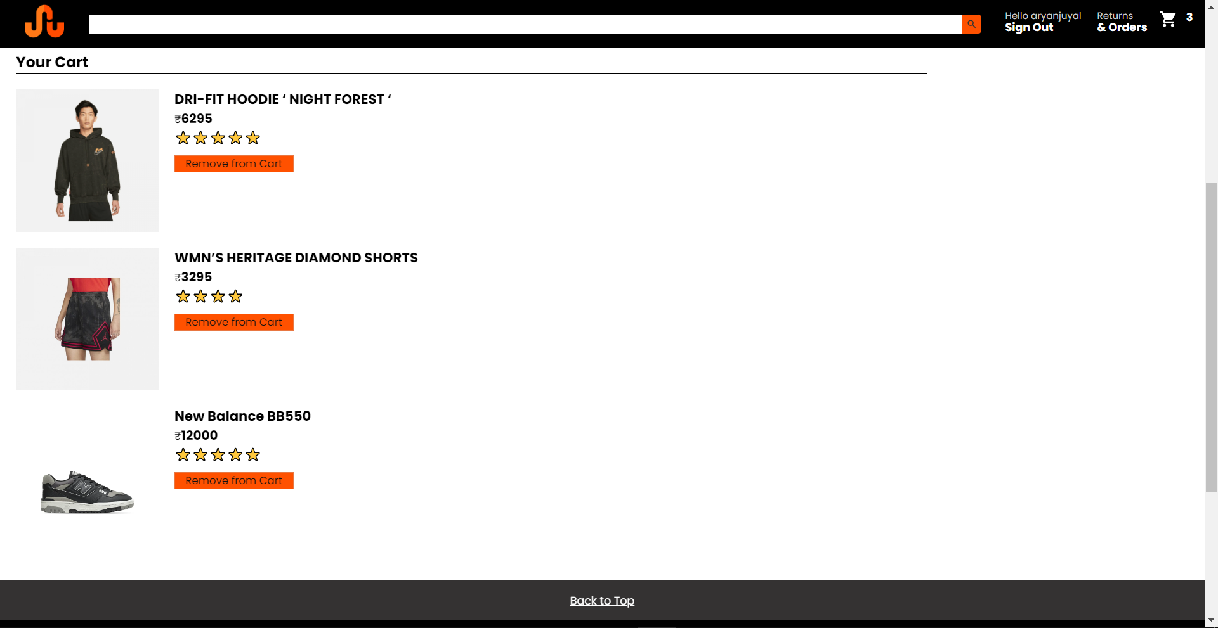
Cart with Items

Slide 26
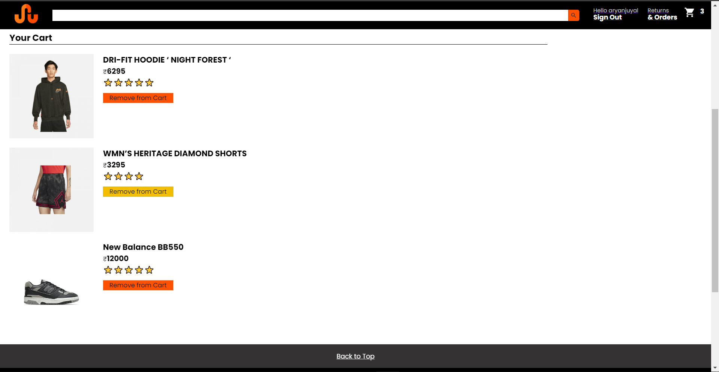
Remove From Cart

Slide 27
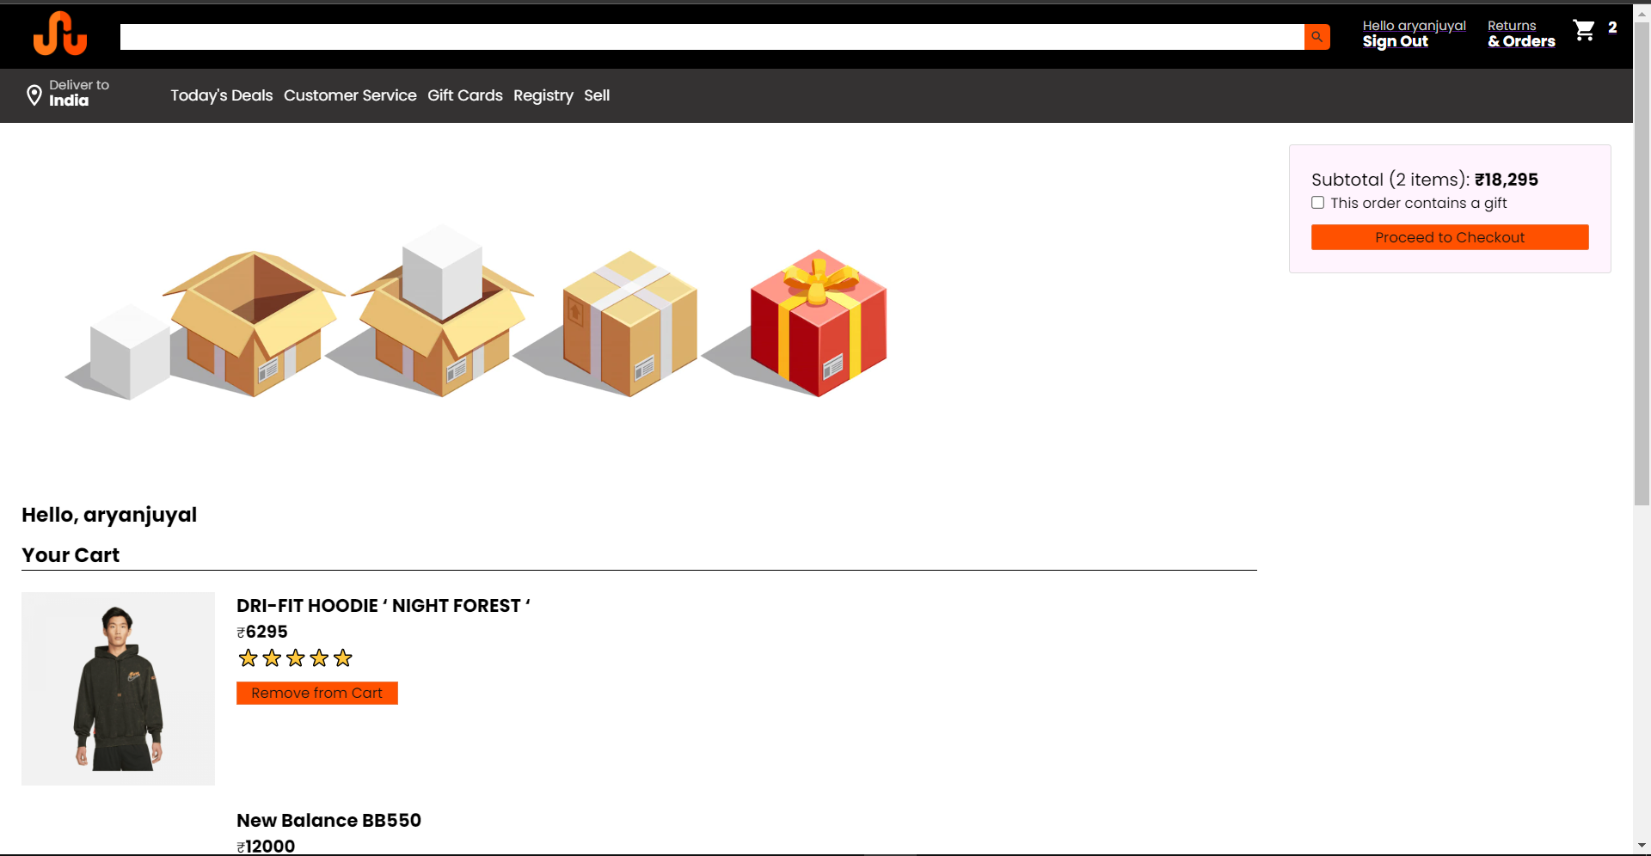
New Cart

Slide 28
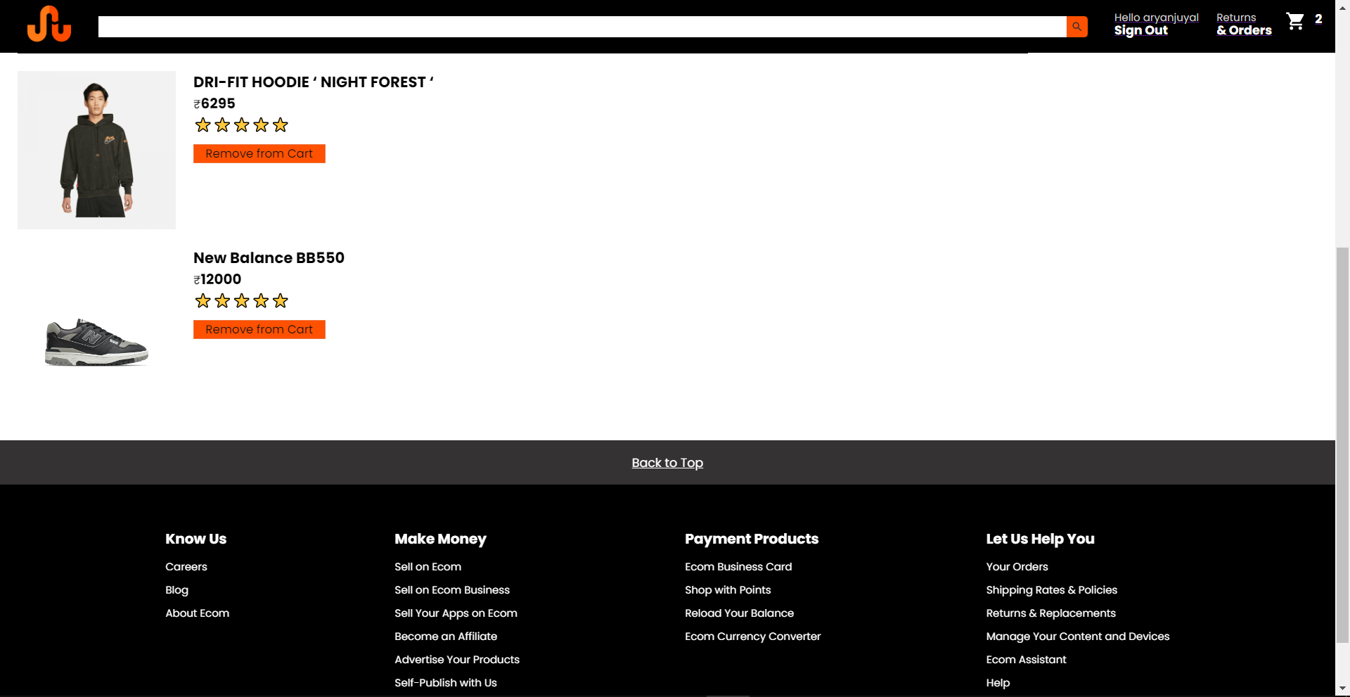
New Cart

Slide 29
Cart Page
Navbar at the top
Displays ad at the top with an empty cart image if no items present.
Subtotal Box showing the user their total.
Hello followed by the username also above the list
As and when items added they get displayed in a list here.
Option to remove from cart.
Footer and Back to top button.

Slide 30
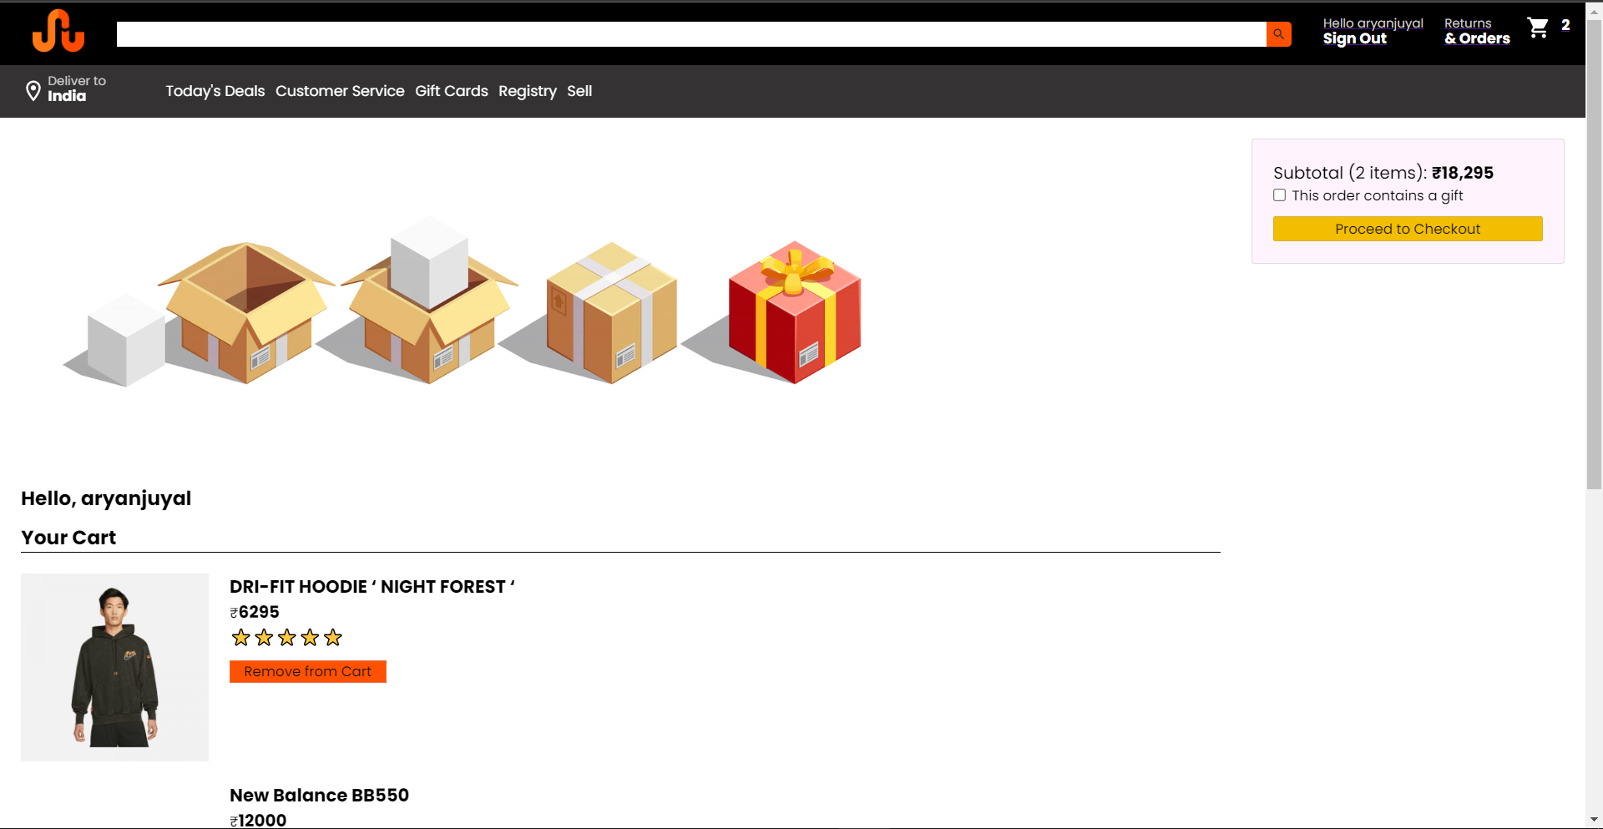
Proceed to Checkout

Slide 31
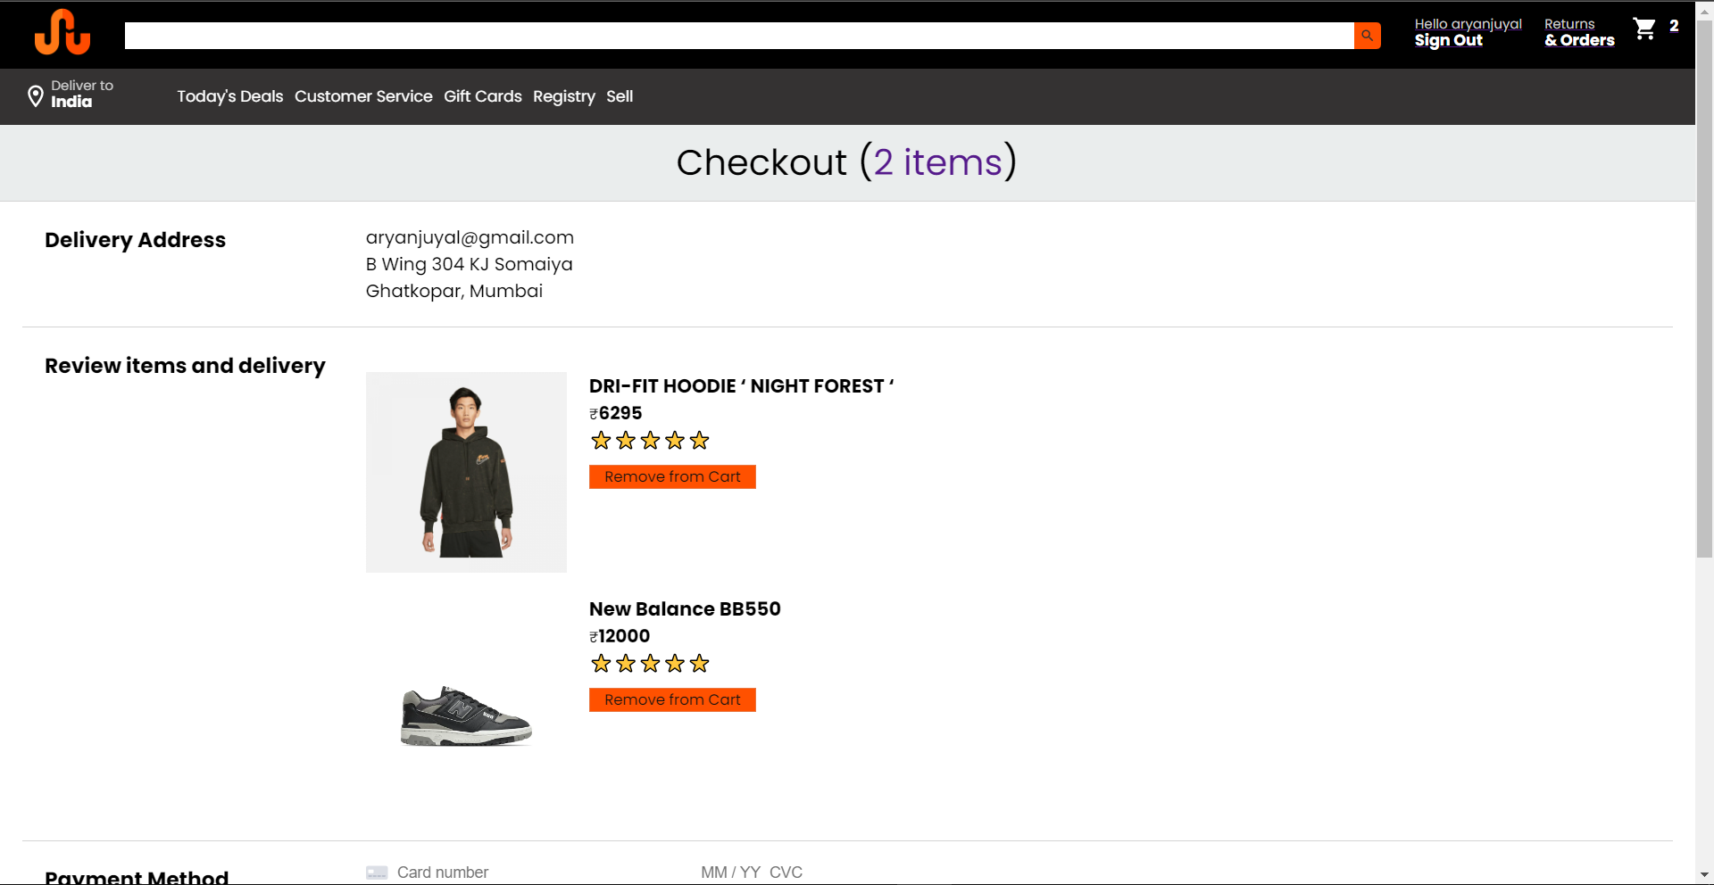
Checkout Page

Slide 32
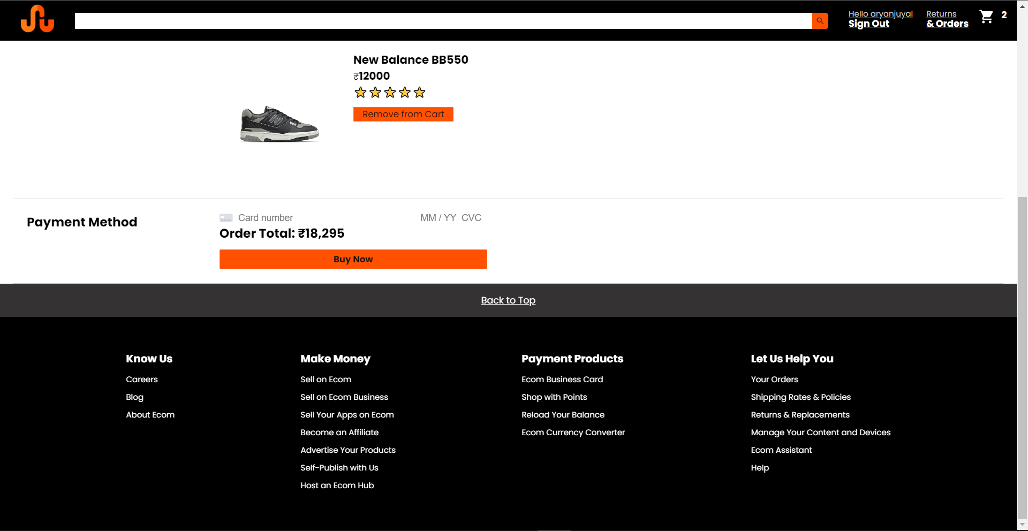
Checkout Page

Slide 33

Checkout Page (Remove from Cart)

Slide 34
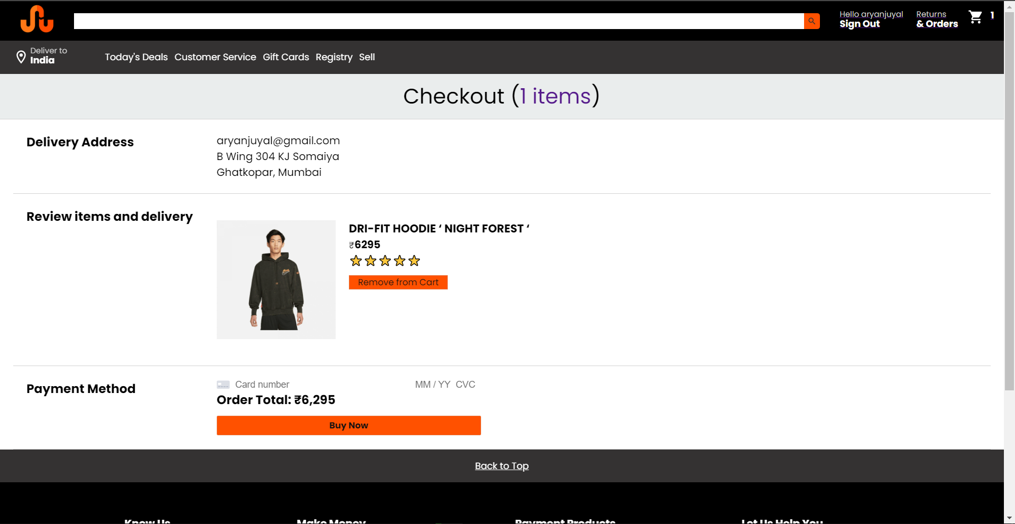
Checkout Page (Remove from Cart)

Slide 35

Checkout Payment (Entering Details)

Slide 36
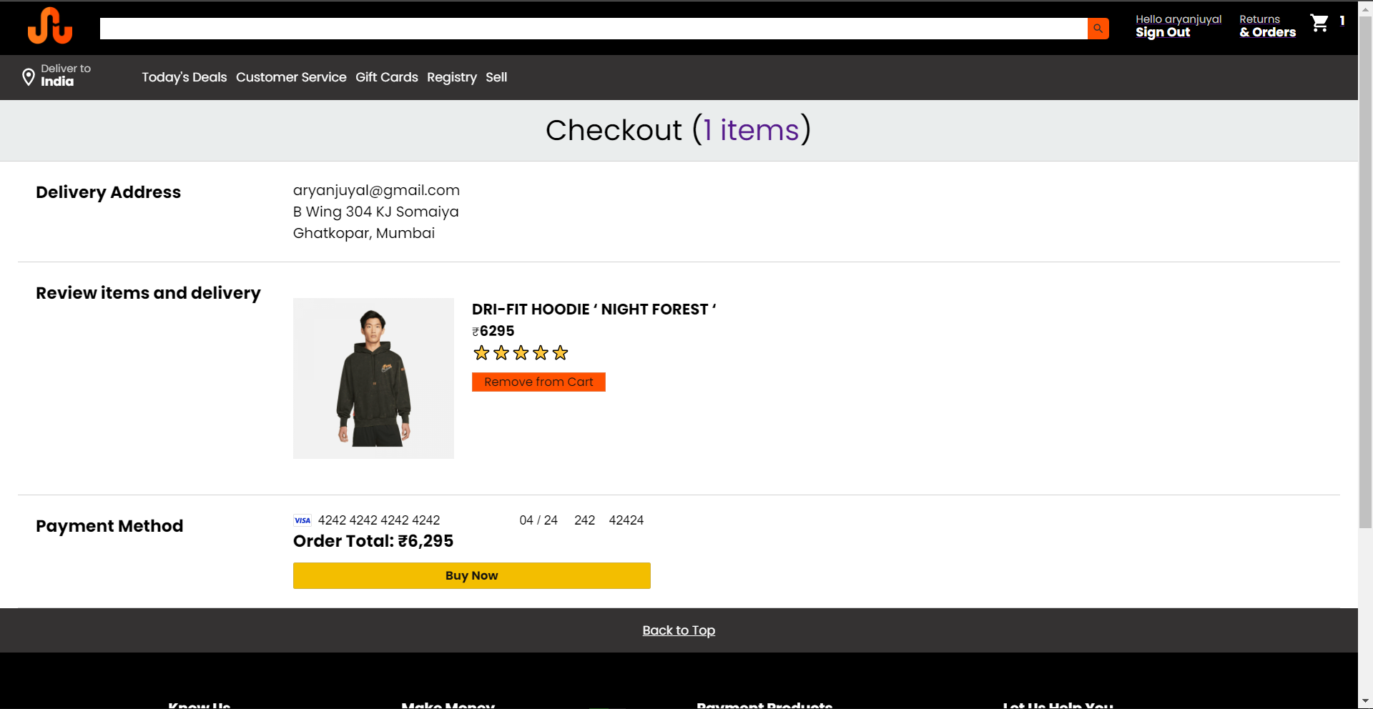
Checkout Payment (Pressing Buy Now)

Slide 37
Payment Page
Navbar at the Top exactly like before
Checkout label showing number of items user has decided to purchase (on pressing links to Cart).
User details and information in one component
Items listed to be purchased in one component
Subtotal displayed in one component
Stripe Card Payment Element to enter your Card Details.
Proceeds with the transaction after pressing buy.

Slide 38
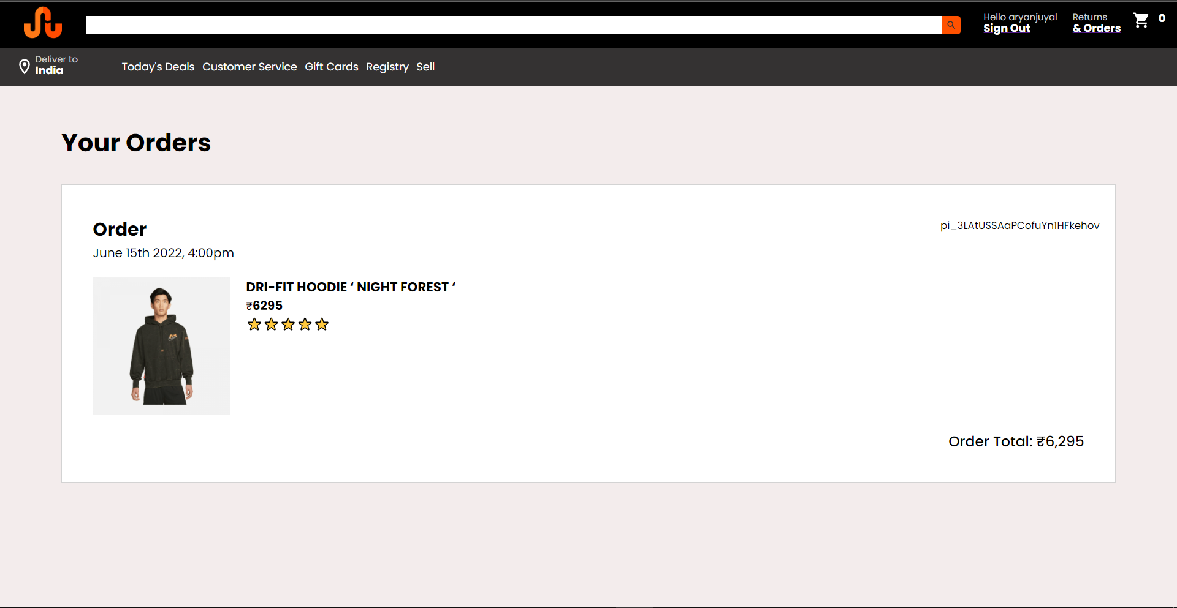
Order Page(After Payment Processing)

Slide 39
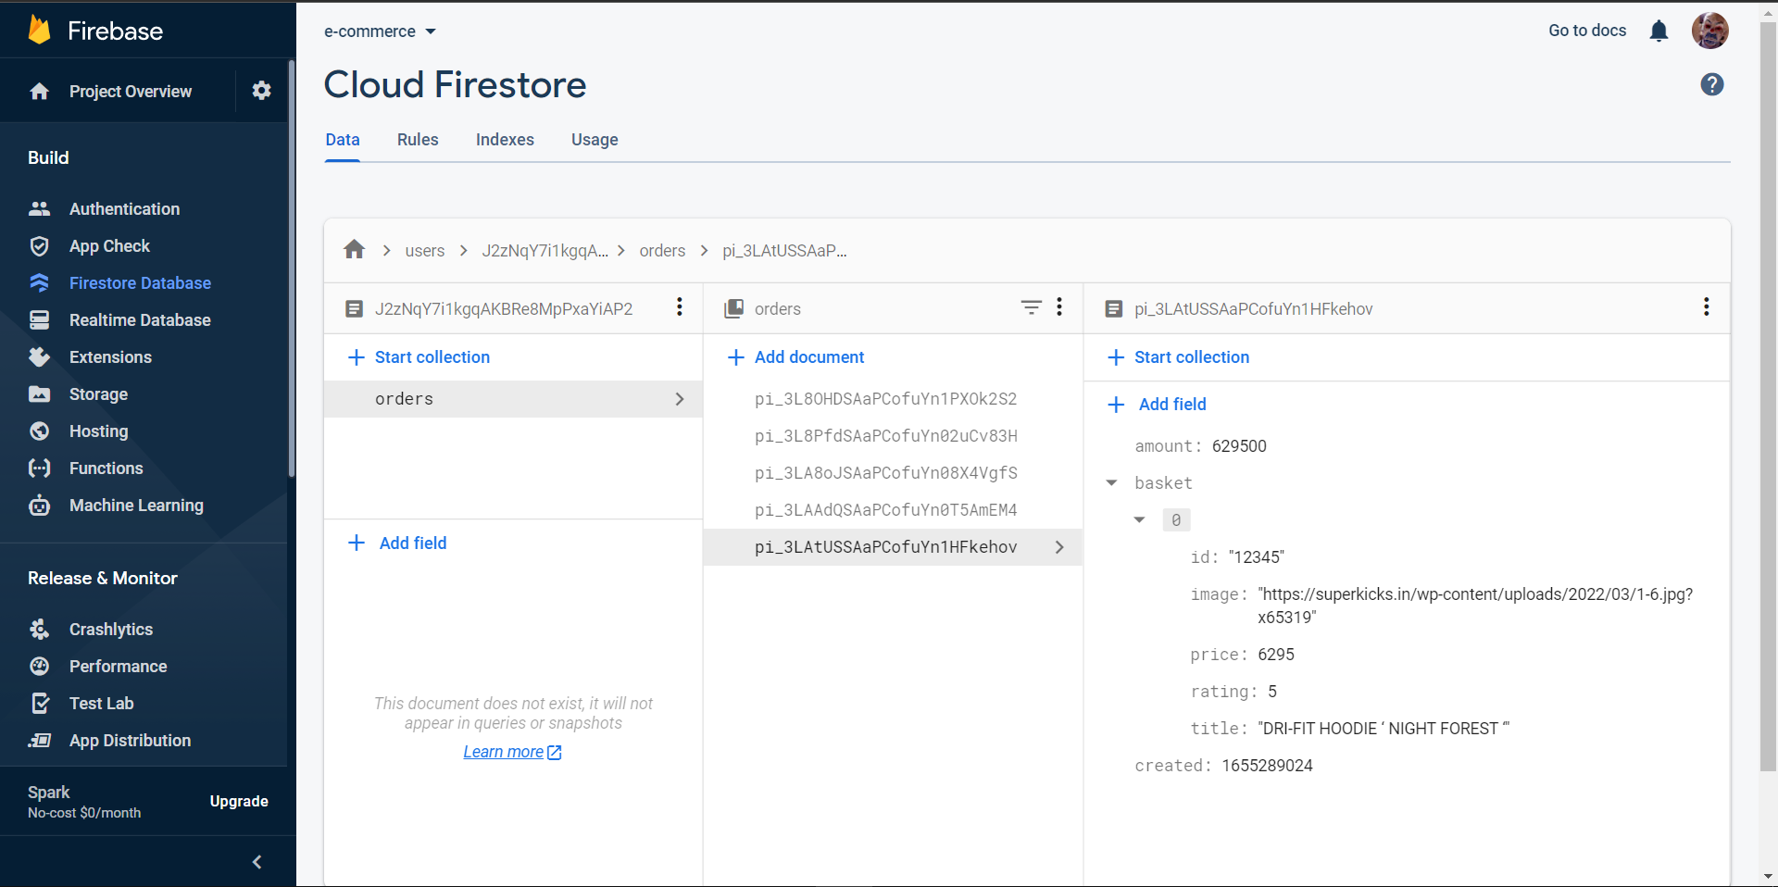
Firestore DB(After Payment Processing)

Slide 40
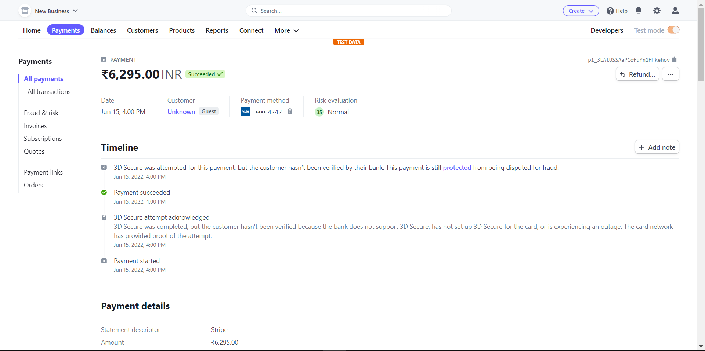
Stripe Dashboard(After Payment Processing)

Slide 41
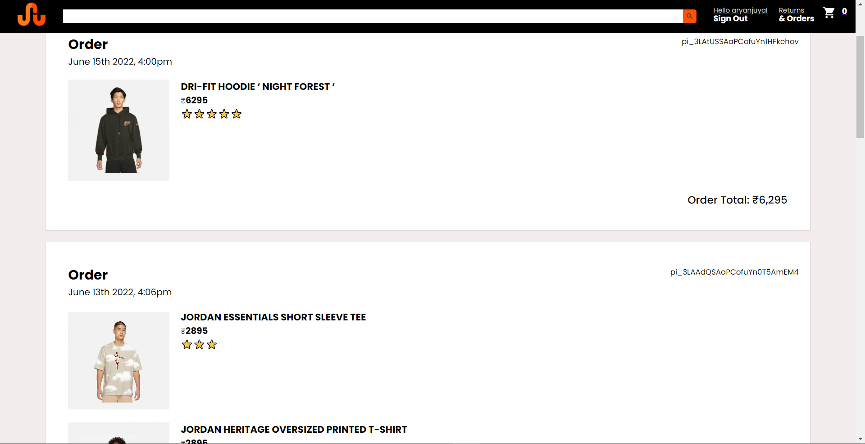
Order Page (Order History)

Slide 42
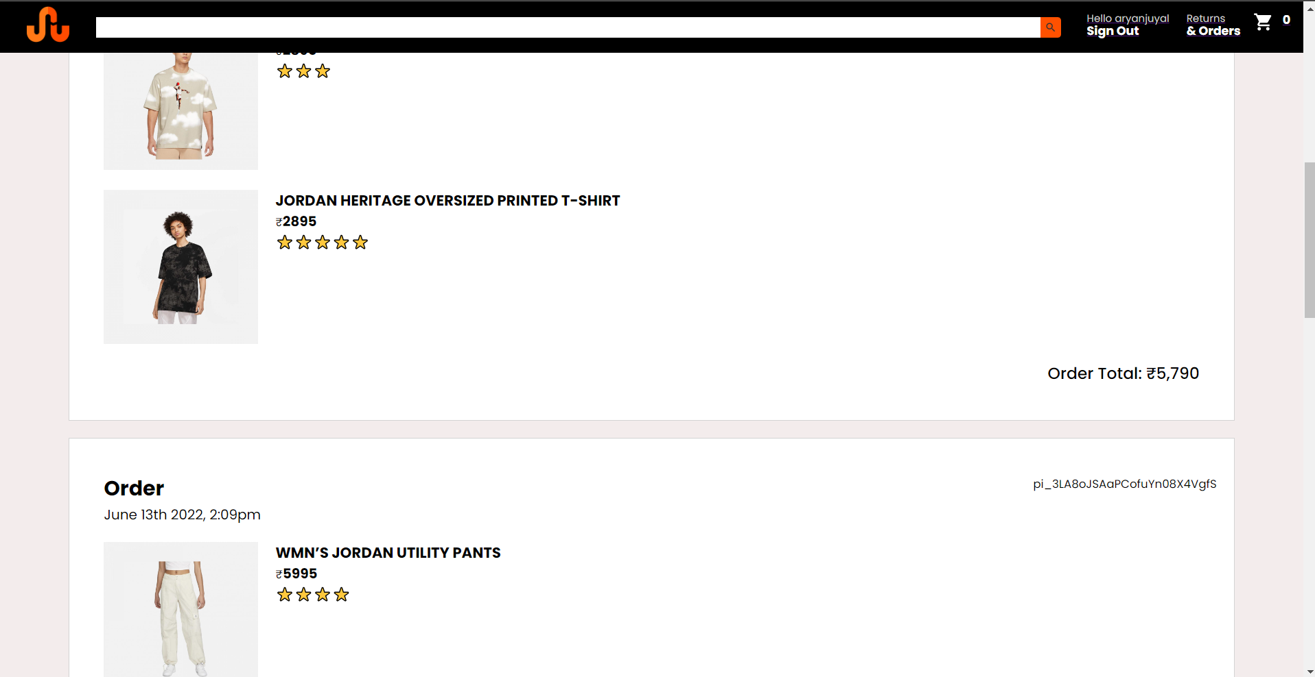
Order Page (Order History)

Slide 43
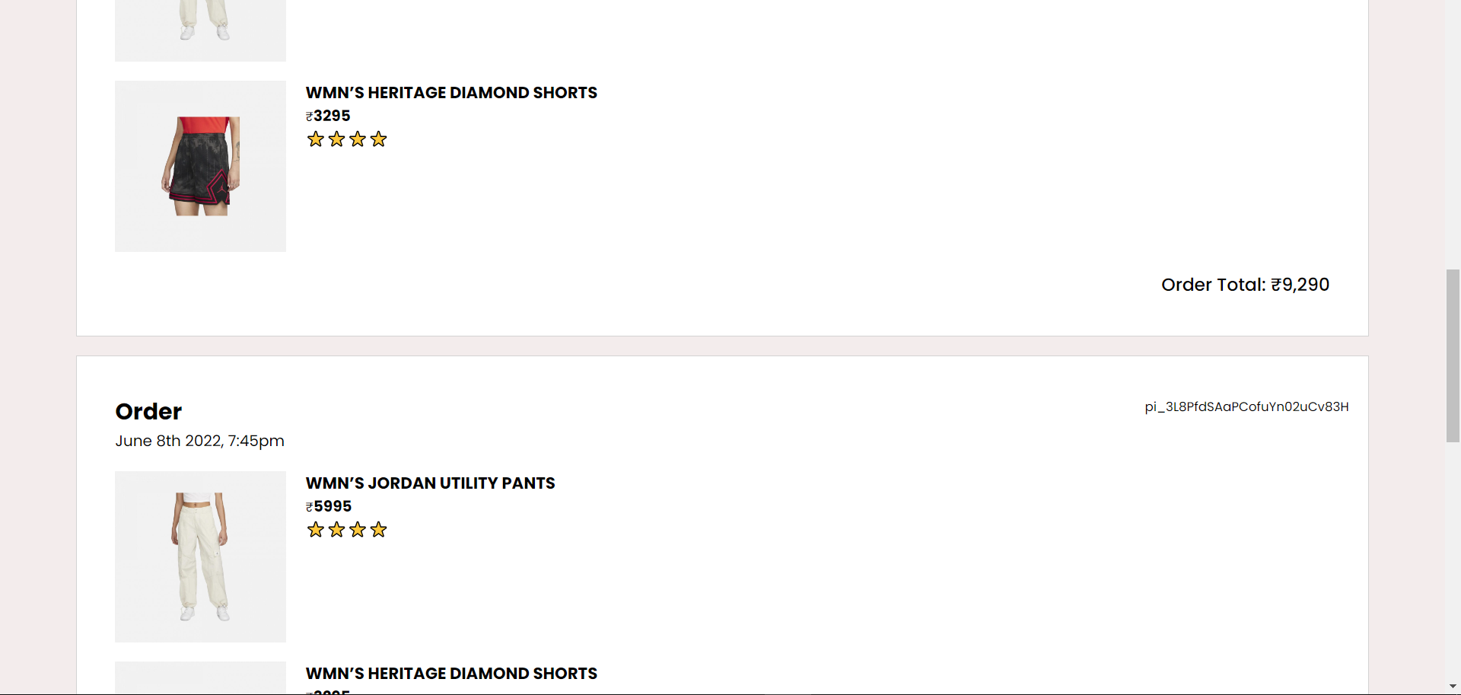
Order Page (Order History)

Slide 44
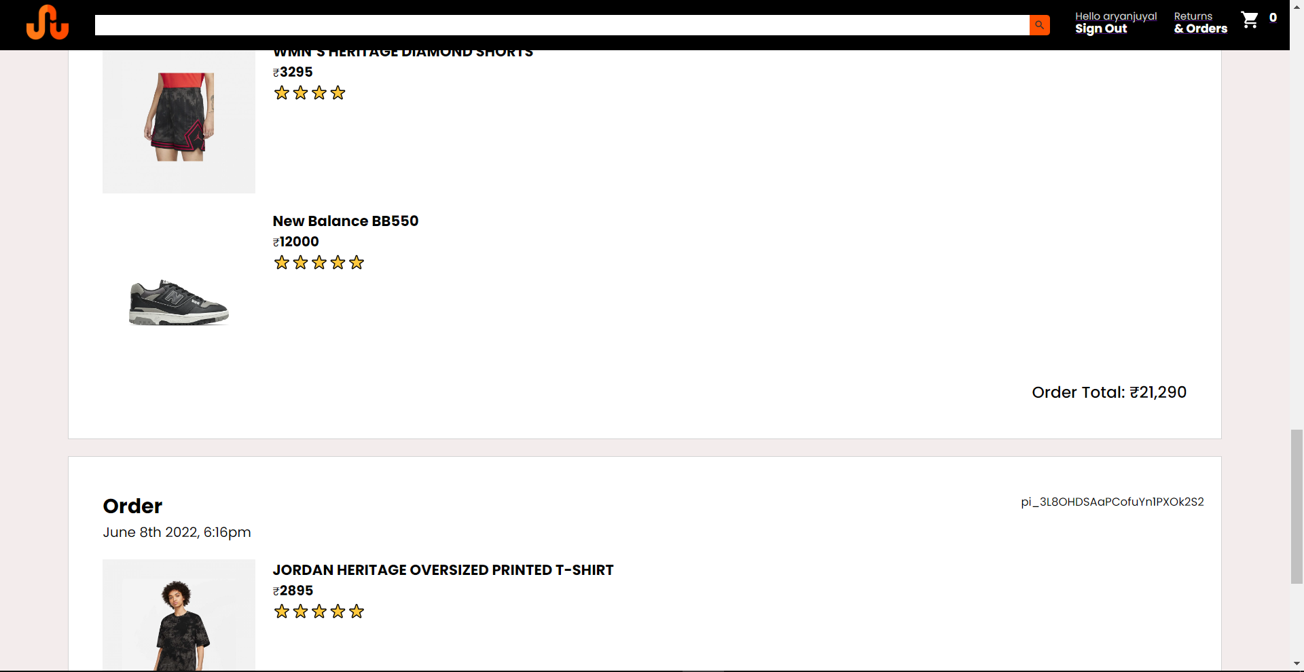
Order Page (Order History)

Slide 45
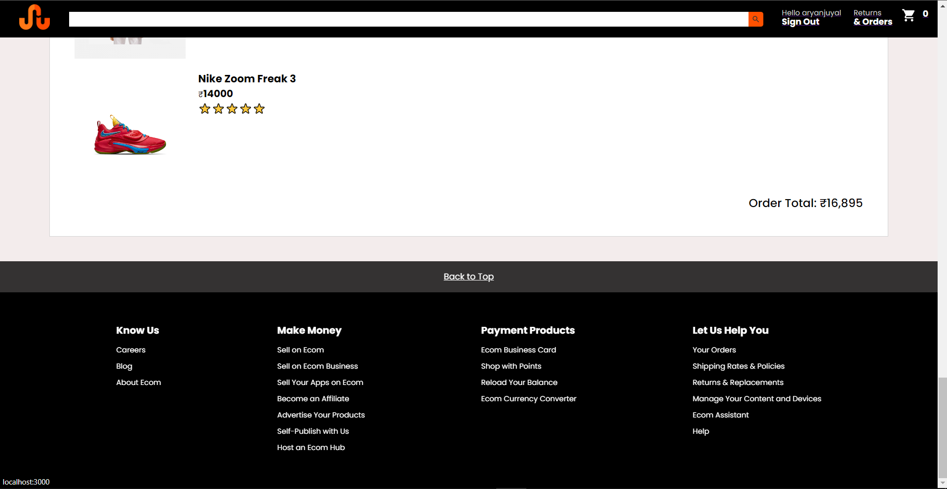
Order Page

Slide 46
Order Page
Contains your current order you placed listed with the time, date and total amount.
Each Order has a unique order id for its identity.
The page will display each and every order you have placed in the past.
Back to top button to go back to the most recent order the user has placed.

Slide 47
How to run this Web App
Run “npm start” in app directory(one terminal)
cd into functions folder
Run “firebase emulators:start”
This app cannot be deployed as of right now because for real time functions to work we need to upgrade to the firebase Blaze plan.

Slide 48
Thank You

